Slide 1
ME/PE COMMUNICATIONS IMPROVEMENT

Slide 2

ME/PE Co-location Optimization
Increase efficiency of REPS work groups
People in the same cubicle communicate more often with each other than with people that sit far away
Seating proximity determines/indicates amount of communication between parties
To improve communications of design and process we should have PEs and MEs located in the same cubicles
Pair Core ME / Core PE (Pinions, BNA, Racks, Housings)
Pair Application DREs and Lead MEs and IEs
Coordinate with Office carpeting activities

Slide 3
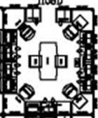
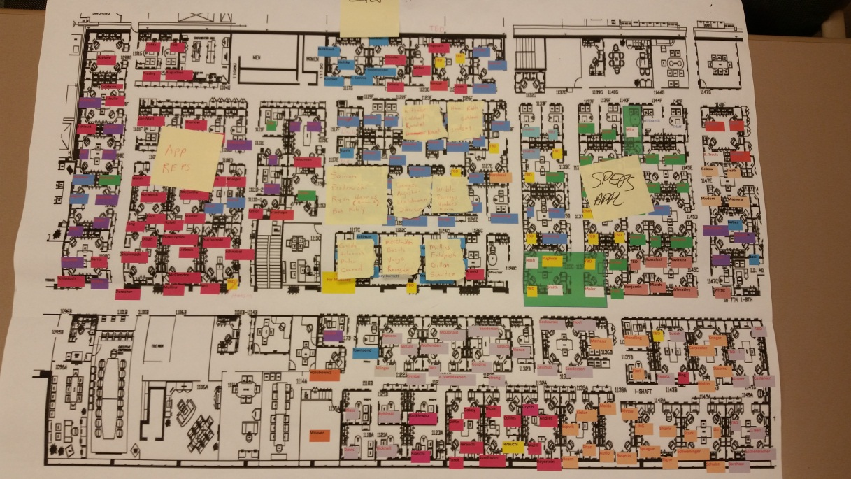
Core ME
Core PE
Core ME
Core PE
DRE
Lead ME
Lead IE

Slide 4
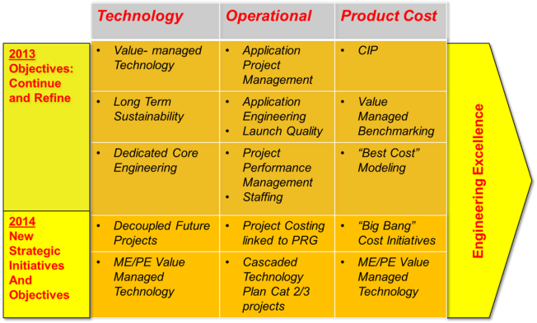


Value Managed Technology

Slide 5
Value-Managed Technology Goals
Develop technologies to meet future customers & business needs
Ensure technology for future market growth and strength
General technology themes include
Return to Manual Mitigation – LoA, Autonomous Driving
Motors – Rotor (IPM, R1=R2)/Stator (Needle, Segment, Shed)
MPP – Reduced package size, cost reductions
Electronics/ECU – EA4.0
Algorithms – Closed Loop, Inertia comp, Torque Steer
Digital Torque and Position Sensors
CEPS/SPEPS/REPS Mechanical – HO A/M, Low cost REPS

Slide 6
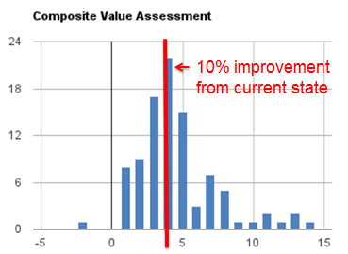

Tech Plan Q3 – Update
All projects assessed, project status reviewed weekly
Scale factor for multiple attributes including
Cost
Mass
Packaging
Performance
Rating scale considers trade offs between attributes
102 Total Active Projects
11.4% Value Improvement average over current state
Quality
Value Stream/Risk Reduction
Developmental Efficiency
Growth Opportunity

Slide 7
Loss of Assist Roadmap
Past
Today
2016
2017
2019+
Fail Safe Manual Steering
Automotive Standard Functional Safety
Enhanced Comfort in Faulted State
Reduced Failure / Warranty Rate
Fail Operational Steering
Most faults revert to manual steering
Engineered to general functional safety standard (IEC 61508)
Most faults revert to manual steering
Engineered to automotive functional safety standards (ISO 26262)
SW backup functions with degraded performance for some faults
Diagnostics design to increase system availability
Utilize existing HW
Limited HW redundancy with full performance for some faults
Reduced failure rate HW design for some subsystems
SW backup functions for some faults
Full or degraded performance under all faults
Required for some ADAS / Autonomous driving
May be required for high load steering applications
Technology adoption rate accelerated by recent GM recalls
Rapid Technology Growth

Slide 8
Key Enablers - System Elements & Design
Electronic Controllers with powerful microcontrollers and multiple communication ports
Software / Algorithms for execution of performance feature logic
Sensor Data Fusion
Higher automation and autonomy require multiple sensors
Reasoning and Decision Making
Actuation Control
Operating System
System Architecture Design
Interconnections of sensors, controllers, and actuators
Partitioning of software functions among controllers
Communication networks (CAN, FlexRay, Ethernet, etc.)
Power distribution
Considerations for fault handling (redundancies, back-up modes), and for product quality

Slide 9
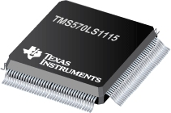
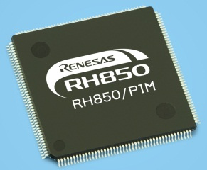
EA3.x vs. EA4.x Technology Comparison Chart
Performance
Communications
Security
AutoSAR
Commercial

Slide 10
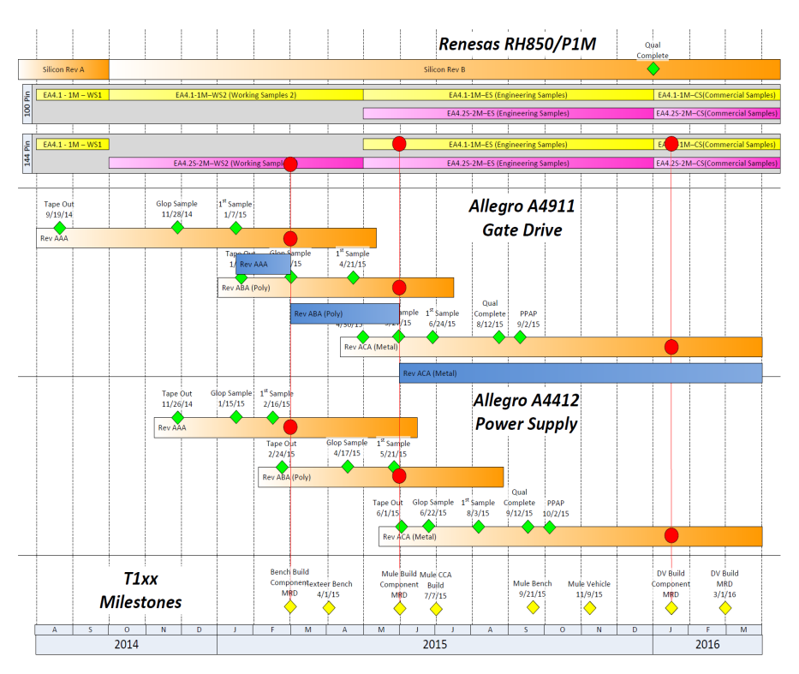
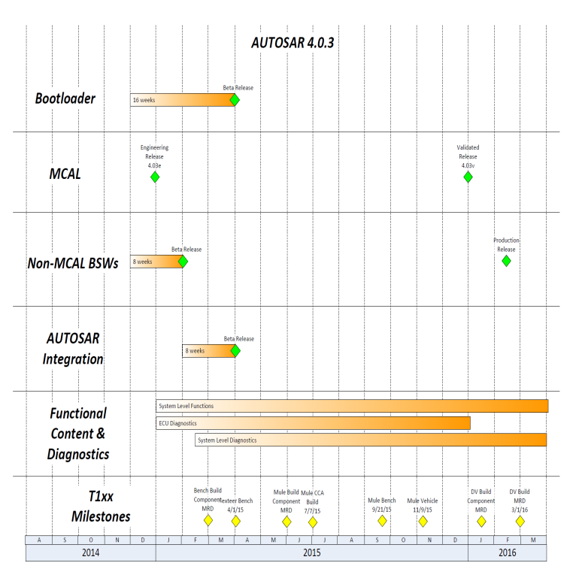
High Level EA4.x Chipset Timing
EA4.x Software Timing
4
5
1
2
6
3
EA4.x hardware is constrained by:
Renesas RH850/P1M Qualification Complete time
Allegro Power Supply (A4412) development time
All EA4.x ICs will have qualification complete prior to DV build
EA4.x sw challenges are:-
Vector kickoff date (for PSA 1V5) will drive early availability of key software components
Established Renesas ASIL-D MCAL dates will pace final AUTOSAR delivery
Functional content and new EA4.x diagnostics phased through DV
EA4.x hardware is on schedule to have all ICs fully qualified prior to (T1xx) DV hardware build
Software timing for AUTOSAR 4.0.3 and new EA4.x diagnostics and functionality is a key focus area

Slide 11
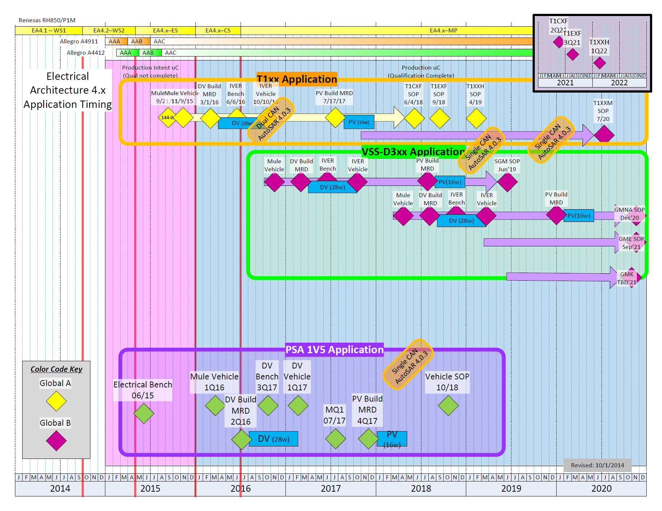
EA4.x Application Timing
Most 1V5 key milestones (including SOP) are shifted by +1Qtr from T1xx milestones
1V5 would have first customer bench delivery. (Content has been defined to be limited.)
PSA 1V5 is timed as a “close follower” application. T1xx would still be the lead application by ~1 quarter.

Slide 12
EA4.x Timing for PSA 1V5 Summary
All major devices (microcontroller, gate drive, power supply) will be qualified prior to DV build
PSA 1V5 application would follow T1xx application by ~1 quarter for most major milestones
Functional content differences will drive some level of unique software
Serial Communications
Single Inverter vs. Dual Inverter
Level 2 vs. Level 3 LoA Mitigation (Sensor Strategy)
Overall, the early development timeline will be constrained mostly by (AUTOSAR 4.0.3 based) software availability
Software will be phased in sprints to manage risk
Both hardware and software are on track to be stable prior to PV build

Slide 13
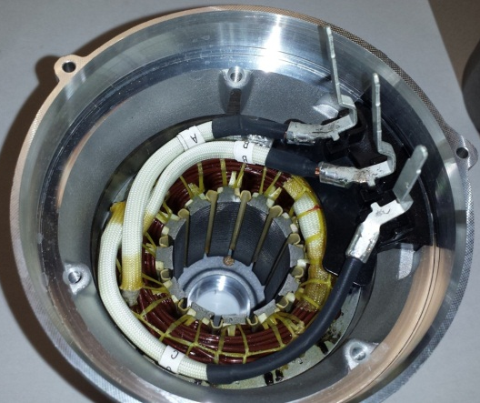
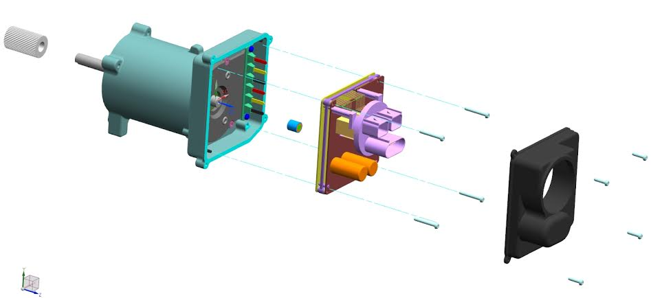
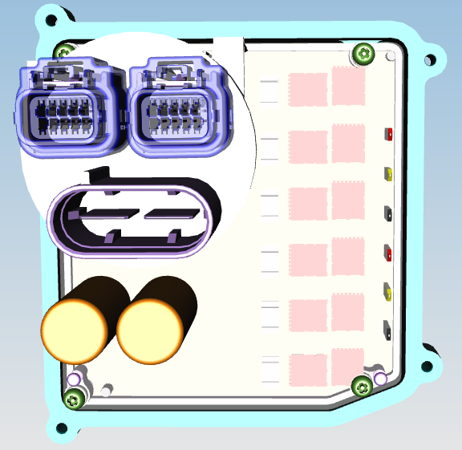
Dual Wound Motor & Dual Inverter
Dual Wound Motor
(6-phase leads instead
of 3-phase leads)
Two Motor/Inverter solutions for:
1. LOA- 12/8 Dual Wound, Dual Inverter and Dual Micro
2. Performance- 12/8 or 9/6 Dual Wound, Dual Inverter and Single Micro.
Dual Inverter CCA
(12-power FETs instead
of 6-power FETs)
Ken Webber Thanks to: Rakib Islam

Slide 14






Quote Challenges Associated with Motors
Leveling up Design Content (Apples to Apples Comparison) based on Suppliers Expertise ….. All Quotes Utilized Segmented Stators
IPM vs SPM (Software Cancellation)
Operating Temperatures and Motor Voltage - Correct with New Speed Torque Curve
Rotor Diameter - Large vs. Small (Inertia)
Winding Configurations confusion associated with 6 Phase Leads
Larger Shaft diameter used internally that Requires a Shaft Reduction for Pulley Assembly

Slide 15
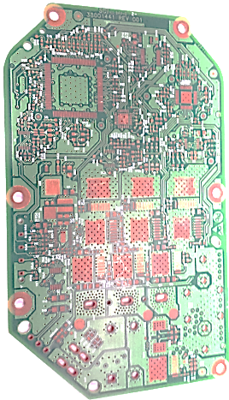
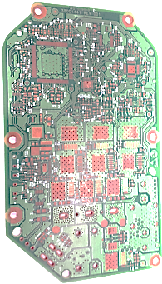
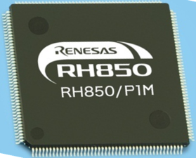
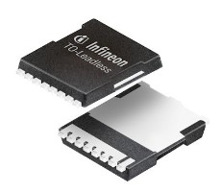
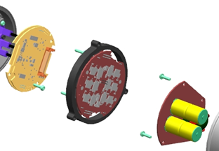
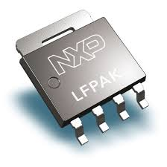
ECU minimization and MPP
Industry demands for more circuit content in future demands
Industry demand for smaller packages
Development work underway to:
Reduce PCB trace spacing and increase component density
Develop and use smaller components
FETS, EA 4.0 Micro, MSB sensor chips
Blind and buried vias, combining vias and test points
Separate single layer boards when required to:
Optimize assembly with compliant pins
Optimize header/leadframe cost and designs
Smaller single layer/end mount still preferred
10x10mm
5x6mm

